Slide 1

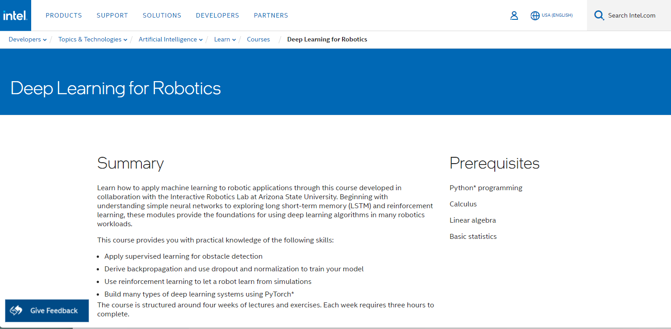

CSC485B Machine Learning for Robotics
SUNY Plattsburgh
Dr. Ned Lecky
Class 17: Some Background

Slide 2

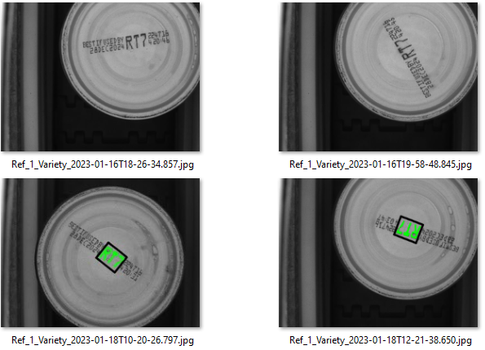


Dimensionality Reduction: LeOCR
Segment into individual characters with classical blob-finding code
Divide into 5x5 grid
Measure Occupation Ratio for all 25 grid squares
Augment data with ratios of Occupation Ratios
NW / SE
NE / SW
Etc. (but not all $\left({25 \atop 2}\right)/2$ =150
Train on many instances of each used character
Vary size, cam angle, print quality
Compute mean and StdDev for all parameters
Build 2-layer NN classifier for each character- computes probability of character being A, B, etc.
Return best match and confidence (how far away is 2nd best match??)
$$Occupation Ratio=\frac{Count of Dark Pixels}{Total Number of Pixels}$$

Slide 3
Dimensionality Reduction
intro: Dimensionality Reduction
Let’s look at our text (Géron): Ch. 8 Dimensionality Reduction
https://github.com/ageron/handson-ml3/blob/main/08_dimensionality_reduction.ipynb

Slide 4
Intel Week 2
Lots of code
Tricky getting it all running
We need some PyTorch background

Slide 5
PyTorch Tutorial Walkthrough
Walkthrough Together
https://pytorch.org/tutorials/beginner/basics/quickstart_tutorial.html

Slide 6
Something Else: ABM
Walk-through:
Thermostat:
http://www.netlogoweb.org/launch#http://www.netlogoweb.org/assets/modelslib/Sample%20Models/Chemistry%20&%20Physics/Thermostat.nlogo
Ant Simulation
http://www.netlogoweb.org/launch#http://www.netlogoweb.org/assets/modelslib/Sample%20Models/Biology/Ants.nlogo
What IS this stuff?? Let’s take a look at:
http://ccl.northwestern.edu/netlogo/
http://ccl.northwestern.edu/netlogo/bind/
More In Depth: Intro to Agent-Based Modeling
https://ebookcentral.proquest.com/lib/plattsburgh-ebooks/reader.action?docID=3339969
This could be an “easy” way to generate training data similar to last week in the Intel course

Slide 7

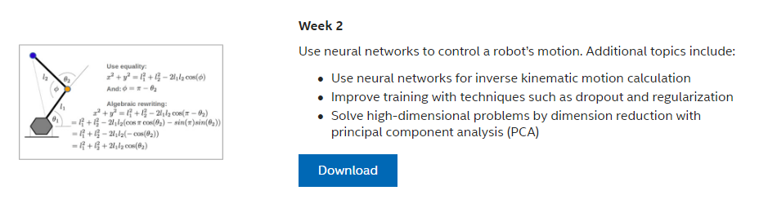



IDLR Week 2

